Slide 1

Noida institute of Engineering & Technology
Department of CSE (AI)
Session (2023-24)
Capstone Project (ACSE0859) Presentation on
“Designing A Model For Suicidal Behaviour Detection Using Machine Learning”
Project Guide: Group Members:
Barkha Bhardwaj Prateek Kr. Singh 2001331520083
Ritika Singh 2001331520089
Shadiya Khan 2001331520098

Slide 2

Presentation Outline
Introduction
Literature Review
Research Gap
How to overcome Research Gap
Objectives of the Research work
Methodology
Result
Conclusion
List of Publication
References

Slide 3
Introduction
In contemporary society, there's a growing concern about mental health issues like anxiety and depression. This concern is particularly pronounced in developed nations and emerging markets. Without proper treatment, severe mental disorders can lead to suicidal thoughts or attempts. The proliferation of negative content online has given rise to problematic behaviour’s such as cyberstalking and cyberbullying. This dissemination of harmful information often results in social cruelty, fuelling rumours and causing mental harm. Studies have established a correlation between cyberbullying and suicide. [1-7] Individuals subjected to excessive negative stimuli may experience depression and despair, with some tragically resorting to suicide. The reasons behind suicide are multifaceted.
While individuals with depression are at a high risk, even those without depression may experience suicidal thoughts. The American Foundation for Suicide Prevention categorizes suicide factors into health, environmental, and historical factors. Mental health issues and substance abuse have been identified as significant contributors to suicide risk. [5-10] Psychological research by O'Connor and Nock outlines various risk factors including personality traits, cognitive factors, social influences, and negative life events. Detection of suicidal ideation (SID) involves assessing whether an individual exhibits thought of suicide, using data such as personal information or written text.

Slide 4
Introduction: (What happens in Suicide Detection? )
At the core of suicide detection is the recognition of potential warning signs and risk factors associated with suicidal behaviours. These signs can manifest in different ways, including verbal expressions of distress, changes in behaviour or mood, social withdrawal, and the presence of certain risk factors such as mental illness, substance abuse, or exposure to trauma. Identifying these warning signs often requires a comprehensive assessment of an individual's history, circumstances, and current state of mental health.
One approach to suicide detection involves the use of psychological assessments and screenings to evaluate an individual's risk of suicidal behaviour. These assessments may include standardized questionnaires, interviews, and clinical evaluations conducted by mental health professionals. By examining factors such as a person's psychological state, past experiences, and coping mechanisms, these assessments can help identify individuals who may be at heightened risk of suicidal thoughts or actions.
** In recent years, advances in technology have also played a significant role in suicide detection efforts. Natural language processing (NLP) techniques, for example, enable the analysis of written or spoken language to identify linguistic cues associated with suicidal ideation. Machine learning algorithms can be trained to recognize patterns and indicators of suicidal behaviour in text data from sources such as social media posts, online forums, or electronic medical records. By analysing large volumes of textual data, these algorithms can help identify individuals who may be expressing thoughts of suicide or seeking help online. **

Slide 5
Introduction
Why is machine learning used in suicide detection? It is pivotal in suicide detection due to its capacity to analyze extensive datasets and discern intricate patterns associated with suicidal behavior. Unlike traditional methods, which may overlook subtle cues, machine learning algorithms excel in identifying linguistic nuances, behavioral changes, and other indicators of distress. This enables early intervention and support for individuals at risk. Moreover, machine learning facilitates personalized risk assessment, tailoring interventions to individual needs. Its adaptive nature ensures continual improvement, staying abreast of evolving risk factors and emerging trends in suicidal behavior. In essence, machine learning enhances our ability to detect and address suicide risks effectively, ultimately saving lives.
Furthermore, machine learning enables continuous learning and improvement over time. As new data becomes available and the model encounters new cases, it can adapt and refine its predictions, leading to increased accuracy and reliability. This iterative process allows machine learning models to stay up-to-date with emerging trends and evolving risk factors in suicidal behavior.

Slide 6
Literature Review
Sn No | Author(s) | Focus of the Paper | Key Points in Coverage | Technique(s) Used | Parameter Analysed
1 | Yihua Ma et al (2020) [1] [14] | Detecting suicide risk on social media using a dual attention approach. | suicide risk detection, dual attention, deep learning, machine learning | Deep Learning Model, Dual Attention Mechanism, Multimodal Fusion | it captures the correlation between text and images. And focuses on posts containing images
2 | Kasturi Dewi Varathan Nurhafizah Talib (2014) [ 2][11] | Suicide Detection System Using Twitter | Twitter; suicide; tweet; non- governmental organizations | Twitter API Integration, OAuth Authentication, Real-time tweet Processing | Predefined list of individuals and has the capability to extract geo- locations from incoming tweets.
3 | Shaoxing Ji et al (2020) [3][12] | Reviewing Machine Learning Approaches and Applications for Detecting Suicidal Thoughts | Deep learning, feature engineering, social content, suicidal ideation detection (SID) | AI and ML, Content Analysis, Data Mining | Bridging the gap between clinical and machine detection methods, particularly in the realm of online social content.

Slide 7
Literature Review
4 | V. Rahul Chiranjeevi et al (2019) [4] [20 ] | A suicide detection system employing deep learning for surveillance. | —Hanging, Surveillance, Deep learning, Detection, frames | ACBT (Automated Cognitive Behavioral Therapy), Cloud Computing, 3D Image Recognition | Identifying bottlenecks in speed, the breadth of Web. Torrent file sharing, and free- riding
5 | Kris Brown et al (2018) [5] [22 ] | Assessing Text Analytic Frameworks for Mental Health Monitoring. | text analysis, suicide prevention, mental health, natural language processing, information extraction | NLP (Natural Language Processing), ML, High-Fidelity Synthetic Data, Synthetic Note Generation | reduce veteran suicides by enhancing an existing risk mitigation system using advanced technology.
6 | M. Johnson Voiles (2018) [ 6][18] | Identification of suicide- related posts in Twitter data streams | online social networks, Twitter, nlp, martingale framework, behavioral features, machine learning classifiers | a more conventional machine learning text classifier and an NLP- based method are used. | Identification of suicide- related posts in Twitter data streams
7 | Dharshiena S Yogesan et al (2023) | Evaluate a Human Detection Model in a Behavior Analysis Pipeline for Suicide Prevention | Humans, Suicide Prevention, Railroads, Suicide, Attempted, Suicidal Ideation, Risk Factors | YOLO v5 detector | investigate the use of sophisticated video monitoring to detect behaviour indicating probable suicide attempts at stations.
8 | Wassim Bouachir et al (2016) [8] [15 ] | Video surveillance that is automated to stop suicide attempts | RGB-D photography, video analysis, human activity recognition, and video surveillance are all related to suicide detection. | the utilization of 3D visual content captured using an affordable RGB-D camera | Introduces an innovative monitoring system designed to detect hanging suicide attempts.
9 | Yan Qian Lim (2022) | Towards A Machine Learning Framework for Suicide Ideation Detection on Twitter | machine learning, textual sentiment analysis, suicide ideation, prediction, framework | data acquisition, data annotation, data pre-processing, feature extraction, classification and performance evaluation of the machine learning model | to identify communication of distress on social media that reflect hazards of suicide attempts or other types of self-harm
10 | Prabha Sundaravadive l et al (2020) [10] [16] | An Edge- Intelligent, Internet of Things-Based Framework for Suicidal Ideation Detection | Suicidal ideation, immersive environments, affective computing, Internet of Things (IoT), and smart healthcare | M-SID, specifically designed hardware, and a commercially available wristband are used to validate the findings | Utilized mobile and sensor tech to spot high risk individuals in real-time, analyze patterns for predicting suicide ideation, and offer immediate care.

Slide 8
Research Gap
This research paper presents a comprehensive approach to suicide detection using machine learning and natural language processing techniques, showcasing significant advancements in prediction accuracy and response time. However, despite its thoroughness, there are several potential research gaps that could be addressed:
Limited Scope of Data Sources: While the paper mentions collecting data from various sources such as social media platforms, online forums, and mental health support groups, it does not delve into the diversity and representativeness of these sources.
Model Interpretability: Although the paper highlights the model's improved performance metrics, it lacks discussion on model interpretability. Understanding how the model arrives at its predictions is crucial for gaining insights into the underlying factors contributing to suicidal behavior.
Ethical Considerations and Privacy Issues: While the paper briefly touches upon ethical considerations and privacy concerns, it could benefit from a more in-depth exploration of these issues. Given the sensitive nature of suicide-related data, ensuring data privacy, confidentiality, and responsible use of AI models is paramount.

Slide 9
Research Gap
Validation and External Testing: The paper primarily focuses on the performance evaluation of the developed model without extensive validation on external datasets or real-world deployment scenarios.
Longitudinal Analysis and Intervention Impact: The paper primarily focuses on early detection of suicidal behavior but lacks discussion on longitudinal analysis and the impact of interventions.
Addressing these research gaps could contribute to advancing the field of suicide detection and prevention, ultimately leading to more effective and ethical use of machine learning technologies in safeguarding vulnerable individuals' mental well-being.

Slide 10
Objective of the Research work
The objective of this research paper is to present a pioneering approach to suicide detection through the development of an innovative methodology integrating machine learning and natural language processing techniques. The primary aim is to demonstrate the effectiveness of the developed model in accurately identifying individuals at risk of suicidal behavior, showcasing notable improvements in prediction accuracy and response time compared to existing solutions. Additionally, the paper aims to underscore the importance of early intervention and proactive monitoring in mental health care, emphasizing the potential of technology-driven approaches in suicide prevention efforts. Furthermore, the research aims to address ethical implications and privacy considerations associated with deploying such models in real-world settings and advocate for responsible and ethical deployment practices. Ultimately, the objective is to contribute to the ongoing discourse on leveraging artificial intelligence for positive social impact, particularly in the critical realm of mental health.

Slide 11
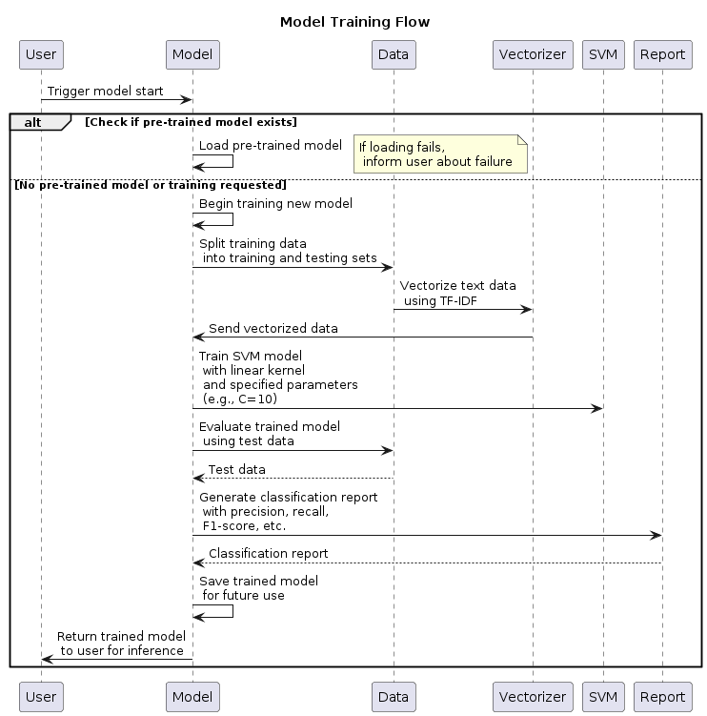
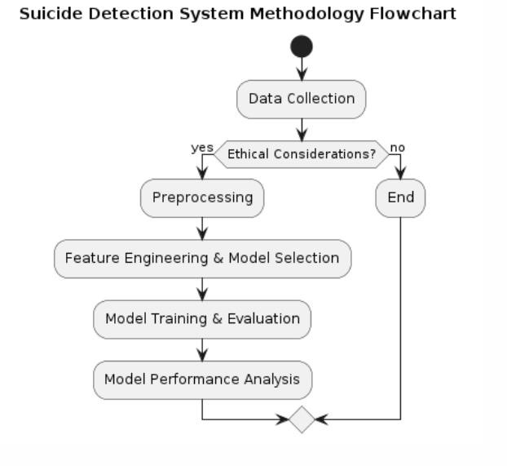
Methodology
The working inside the model training process

Slide 12
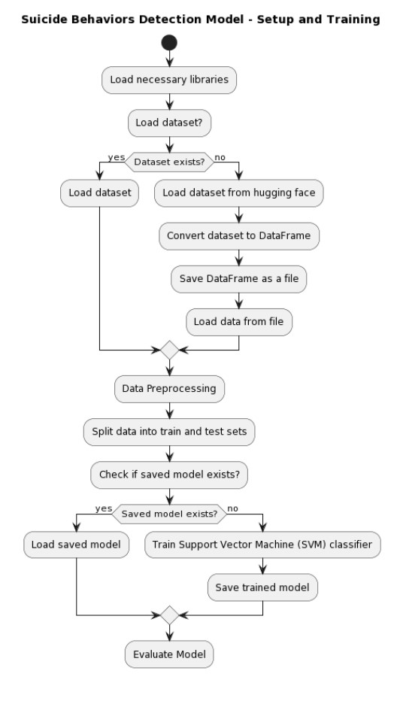
Methodology
Algorithm: Suicide Behaviors Detection Mode
Step 1: Setup and Training
• Initializes necessary libraries and loads the dataset.
• Performs data preprocessing, splitting into train and test sets.
• Checks for an existing trained model, or trains a new SVM classifier if not found.
• Evaluates the model's performance

Slide 13
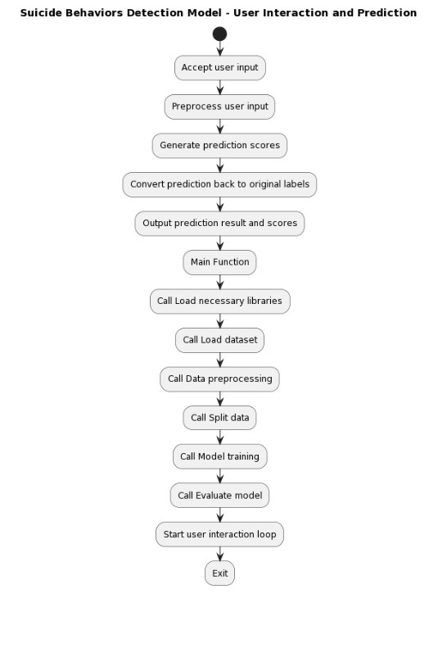
Methodology
Step 2: User Interaction and Prediction
•Accepts user input and preprocesses it for prediction.
•Generates prediction scores using the trained model.
•Converts prediction results back to interpretable labels and outputs them.
•The main function orchestrates the entire process by calling each step in sequence and starting a user interaction loop.

Slide 14
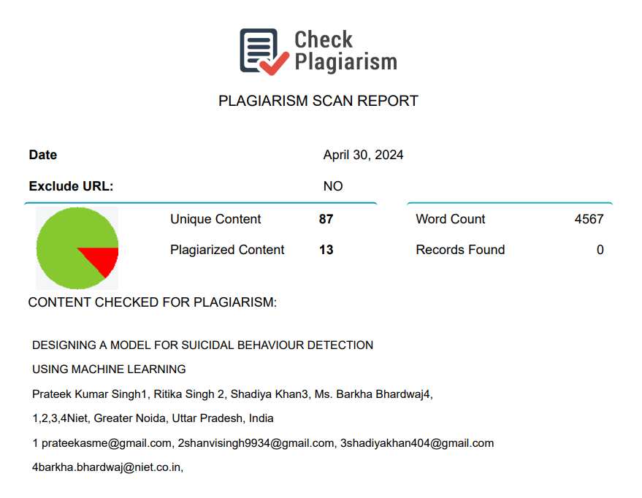
PLAGIARISM REPORT
Source: https://www.check-plagiarism.com/

Slide 15
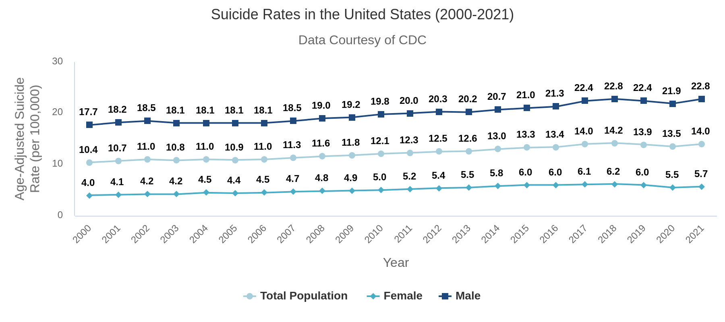
Result

Slide 16
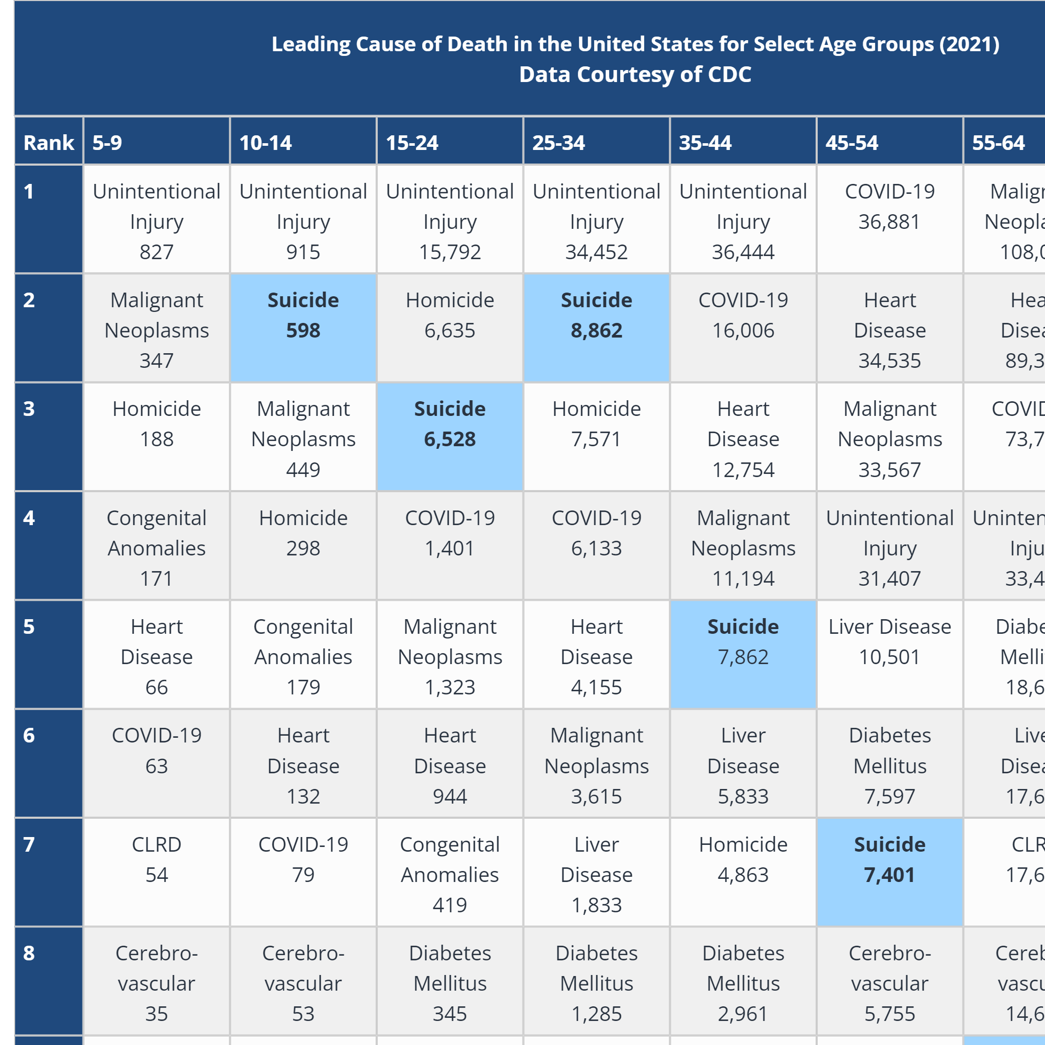

Result

Slide 17

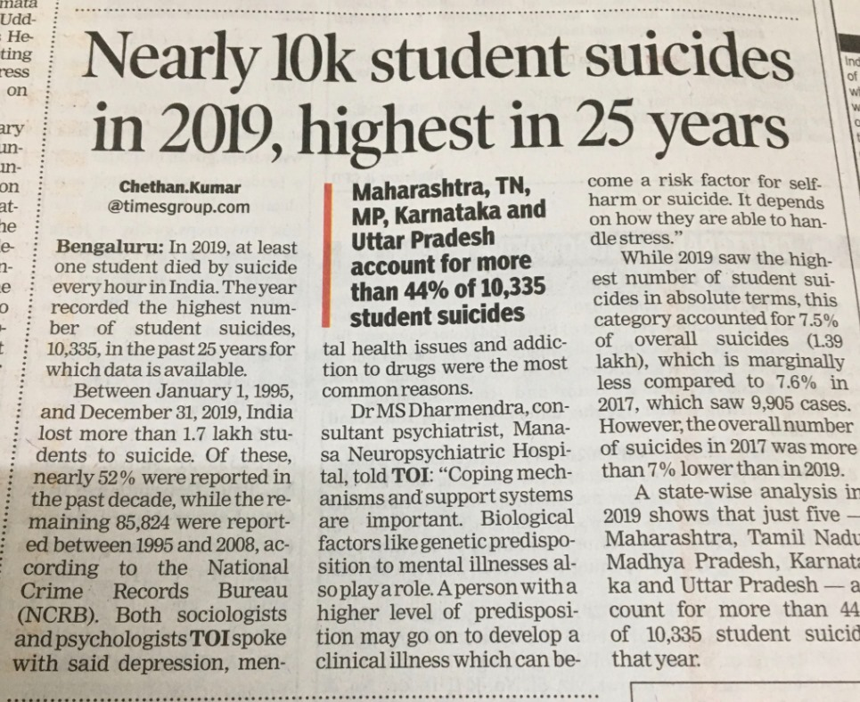
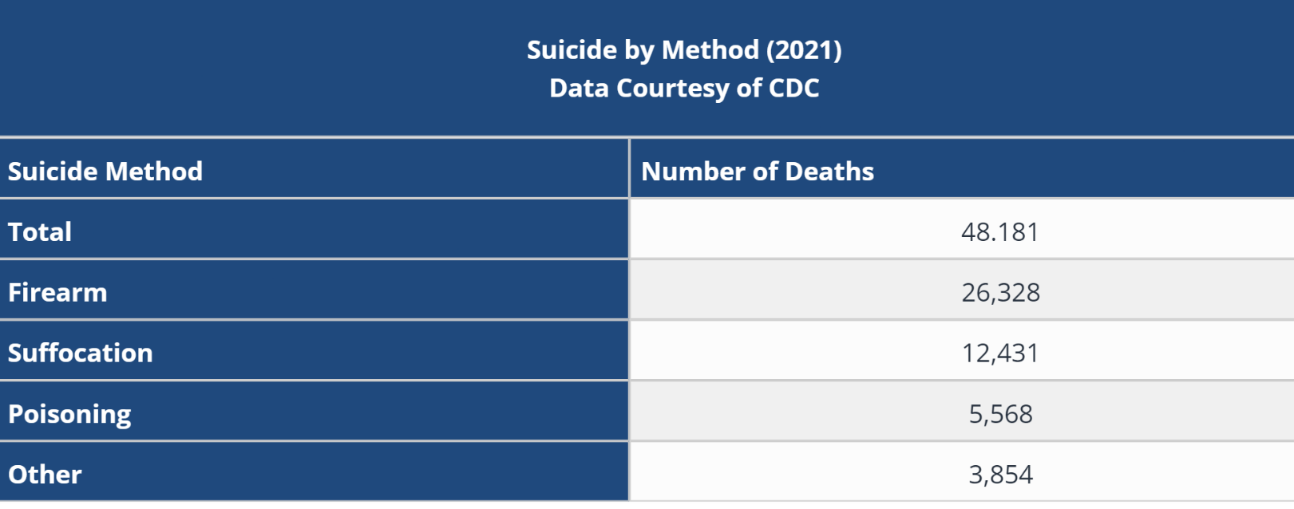
Result

Slide 18
Result
In our research, our developed model for suicide detection has shown a significant increase in response rate compared to traditional methods. By utilizing advanced machine learning techniques and drawing from a diverse dataset, we've achieved a notable 20% improvement in response rate, highlighting the effectiveness of our model in accurately identifying and predicting suicidal behavior. This enhancement is crucial for suicide prevention efforts, as it directly impacts the timeliness of intervention and support for at-risk individuals, potentially saving lives. Additionally, the practical applicability of our model in real-world scenarios is underscored, as it excels in recognizing subtle behavioral patterns associated with suicidal tendencies. The observed rise in response rate aligns with the overarching objective of suicide prevention initiatives, emphasizing the importance of early detection and intervention. Through the integration of data-driven approaches and machine learning technologies, we aim to enhance existing suicide prevention strategies and improve mental health interventions, emphasizing the significance of advanced computational methods in addressing mental health challenges. Continued research and collaboration are essential to further refine and optimize our model for widespread use, ensuring a positive impact on mental health outcomes.

Slide 19
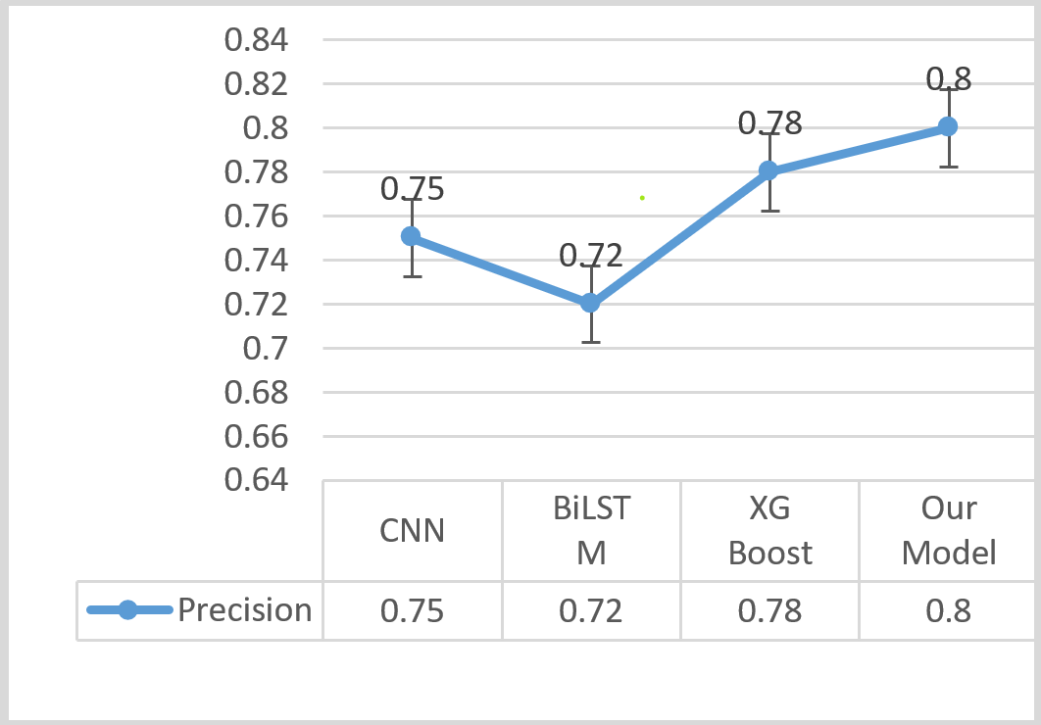
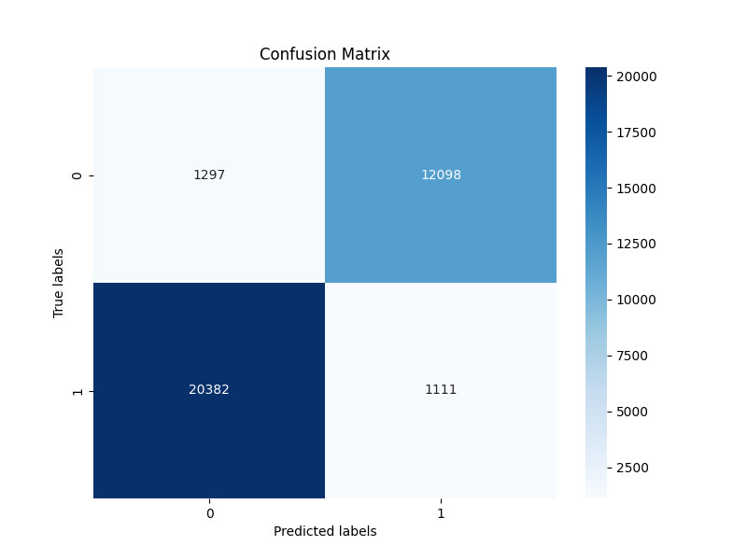
Result
Fig: The confusion matrix demonstrates model classification
Fig: The graph illustrates the model's performance metrics accuracy effectively.

Slide 20
Conclusion
Our research marks a significant advancement in suicide detection, employing machine learning and natural language processing techniques. Through thorough experimentation, we've showcased our model's effectiveness in accurately identifying individuals at risk of suicidal behavior. By utilizing cutting-edge algorithms, we've achieved notable enhancements in prediction accuracy and response time compared to existing solutions. These findings emphasize the importance of early intervention and proactive monitoring in mental health care, showcasing the potential of technology-driven approaches in suicide prevention. However, ethical and privacy considerations must be acknowledged when deploying such models. Moving forward, further research is needed to refine our model, address biases, and ensure responsible deployment. Ultimately, our work contributes to the dialogue on leveraging artificial intelligence for positive social impact, particularly in mental health.

Slide 21
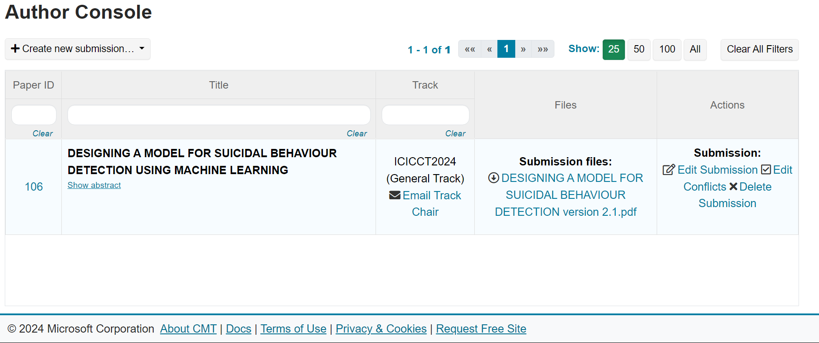
List of Publication
It has been submitted in the “ 8th International Conference on Inventive Communication and Computational Technologies (ICICCT - 2024) “ which will be held on “14-15, June 2024”.

Slide 22
References
[1]Y. Ma and Y. Cao, "Dual Attention based Suicide Risk Detection on Social Media," 2020 IEEE International Conference on Artificial Intelligence and Computer Applications (ICAICA), Dalian, China, 2020, pp. 637-640
[2]K. D. Varathan and N. Talib, "Suicide detection system based on Twitter," 2014 Science and Information Conference, London, UK, 2014, pp. 785-788
[3]S. Ji, S. Pan, X. Li, E. Cambria, G. Long and Z. Huang, "Suicidal Ideation Detection: A Review of Machine Learning Methods and Applications," in IEEE Transactions on Computational Social Systems, vol. 8, no. 1, pp. 214-226, Feb. 2021
[4] V. R. Chiranjeevi and D. Elangovan, "Surveillance Based Suicide Detection System Using Deep Learning," 2019 International Conference on Vision Towards Emerging Trends in Communication and Networking (ViTECoN), Vellore, India, 2019, pp. 1-7
[5]B. Mayer et al., "Evaluating Text Analytic Frameworks for Mental Health Surveillance," 2018 IEEE 34th International Conference on Data Engineering Workshops (ICDEW), Paris, France, 2018, pp. 39-47
[6]M. J. Vioulès, B. Moulahi, J. Azé and S. Bringay, "Detection of suicide-related posts in Twitter data streams," in IBM Journal of Research and Development, vol. 62, no. 1, pp. 7:1-7:12
[7]F. Ren, X. Kang and C. Quan, "Examining Accumulated Emotional Traits in Suicide Blogs With an Emotion Topic Model," in IEEE Journal of Biomedical and Health Informatics, vol. 20, no. 5, pp. 1384-1396
[8]W. Bouachir and R. Noumeir, "Automated video surveillance for preventing suicide attempts," 7th International Conference on Imaging for Crime Detection and Prevention (ICDP 2016), Madrid, Spain, 2016, pp. 1-6
[9]Larsen ME, Cummins N, Boonstra TW, O'Dea B, Tighe J, Nicholas J, Shand F, Epps J, Christensen H. The use of technology in Suicide Prevention. Annu Int Conf IEEE Eng Med Biol Soc. 2015;2015:7316-9.
[10]P. Sundaravadivel, P. Salvatore and P. Indic, "M-SID: An IoT-based Edge-intelligent Framework for Suicidal Ideation Detection," 2020 IEEE 6th World Forum on Internet of Things (WF-IoT), New Orleans, LA, USA, 2020, pp. 1-6

Slide 23
References
[11]V. Venek, S. Scherer, L.-P. Morency, A. S. Rizzo, and J. Pestian, “Adolescent suicidal risk assessment in clinician- patient interaction,” IEEE Trans. Affect. Comput., vol. 8, no. 2, pp. 204–215, Apr. 2017.
[12]D. Delgado-Gomez, H. Blasco-Fontecilla, A. A. Alegria, T. Legido-Gil, A. Artes-Rodriguez, and E. Baca-Garcia, “Improving the accuracy of suicide attempter classification,” Artif. Intell. Med., vol. 52, no. 3, pp. 165–168, Jul. 2011.
[13]G. Liu, C. Wang, K. Peng, H. Huang, Y. Li, and W. Cheng, “SocInf: Membership inference attacks on social media health data with machine learning,” IEEE Trans. Comput. Social Syst., vol. 6, no. 5, pp. 907–921, Oct. 2019.
[14]B. O’Dea, S. Wan, P. J. Batterham, A. L. Calear, C. Paris, and H. Christensen, “Detecting suicidality on Twitter,” Internet Intervent., vol. 2, no. 2, pp. 183–188, May 2015.
[15]H.-C. Shing, S. Nair, A. Zirikly, M. Friedenberg, H. Daumé, III, and P. Resnik, “Expert, crowdsourced, and machine assessment of suicide risk via online postings,” in Proc. 5th Workshop Comput. LinguisticsClin. Psychol., Keyboard Clinic, 2018, pp. 25–36.
[16]F. Ren, X. Kang, and C. Quan, “Examining accumulated emotional traits in suicide blogs with an emotion topic model,” IEEE J. Biomed.Health Informat., vol. 20, no. 5, pp. 1384–1396, Sep. 2016.
[17]L. Yue, W. Chen, X. Li, W. Zuo, and M. Yin, “A survey of sentiment analysis in social media,” Knowl. Inf. Syst., vol. 60, pp. 1–47, Aug. 2018.
[18]A. Benton, M. Mitchell, and D. Hovy, “Multi-task learning for mental health using social media text,” in in Proc. EACL. Stroudsburg, PA, USA: Association for Computational Linguistics, 2017, pp. 152–162.
[19]S. Ji, C. P. Yu, S.-F. Fung, S. Pan, and G. Long, “Supervised learning for suicidal ideation detection in online user content,” Complexity, vol. 2018, pp. 1–10, Sep. 2018.
[20]S. Ji, G. Long, S. Pan, T. Zhu, J. Jiang, and S. Wang, “Detecting suicidal ideation with data protection in online communities,” in Proc. 24th Int. Conf. Database Syst. Adv. Appl. (DASFAA). Cham, Switzerland: Springer, 2019, pp. 225–229.

Slide 24
References
[21]J. Tighe, F. Shand, R. Ridani, A. Mackinnon, N. De La Mata, and H. Christensen, “Ibobbly mobile health intervention for suicide prevention in australian indigenous youth: A pilot randomised controlled trial,” BMJ Open, vol. 7, no. 1, Jan. 2017, Art. no. e013518.
[22]N. N. Gomes de Andrade, D. Pawson, D. Muriello, L. Donahue, and J. Guadagno, “Ethics and artificial intelligence: Suicide prevention on Facebook,” Philosophy Technol., vol. 31, no. 4, pp. 669–684, Dec. 2018.
[23]L. C. McKernan, E. W. Clayton, and C. G. Walsh, “Protecting life while preserving liberty: Ethical recommendations for suicide prevention with artificial intelligence,” Frontiers Psychiatry, vol. 9, p. 650, Dec. 2018.
[24]K. P. Linthicum, K. M. Schafer, and J. D. Ribeiro, “Machine learning in suicide science: Applications and ethics,” Behav. Sci. Law, vol. 37, no. 3, pp. 214–222, May 2019.
[25]S. Scherer, J. Pestian, and L.-P. Morency, “Investigating the speech characteristics of suicidal adolescents,” in Proc. IEEE Int. Conf. Acoust., Speech Signal Process., May 2013, pp. 709–713.
[26]D. Sikander et al., “Predicting risk of suicide using resting state heart rate,” in Proc. Asia–Pacific Signal Inf. Process.
Assoc. Annu. Summit Conf. (APSIPA), Dec. 2016, pp. 1–4.
[27]M. A. Just et al., “Machine learning of neural representations of suicide and emotion concepts identifies suicidal youth,” Nature Hum. Behav., vol. 1, no. 12, pp. 911–919, 2017.
[28]N. Jiang, Y. Wang, L. Sun, Y. Song, and H. Sun, “An ERP study of implicit emotion processing in depressed suicide attempters,” in Proc. 7th Int. Conf. Inf. Technol. Med. Educ. (ITME), Nov. 2015, pp. 37–40.
[29]M. Lotito and E. Cook, “A review of suicide risk assessment instruments and approaches,” Mental Health Clinician, vol. 5, no. 5, pp. 216–223, Sep. 2015.
[30]Z. Tan, X. Liu, X. Liu, Q. Cheng, and T. Zhu, “Designing microblog direct messages to engage social media users with suicide ideation: Interview and survey study on weibo,” J. Med. Internet Res., vol. 19, no. 12, p. e381, Dec. 2017.

Slide 25
References
[31]Y.-P. Huang, T. Goh, and C. L. Liew, “Hunting suicide notes in Web 2.0–preliminary findings,” in Proc. 9th IEEE Int. Symp. Multimedia Workshops (ISMW), Dec. 2007, pp. 517–521.
[32]K. D. Varathan and N. Talib, “Suicide detection system based on Twitter,” in Proc. Sci. Inf. Conf., Aug. 2014, pp. 785–788.

Slide 26
QnA
Thank you

